Slide 1
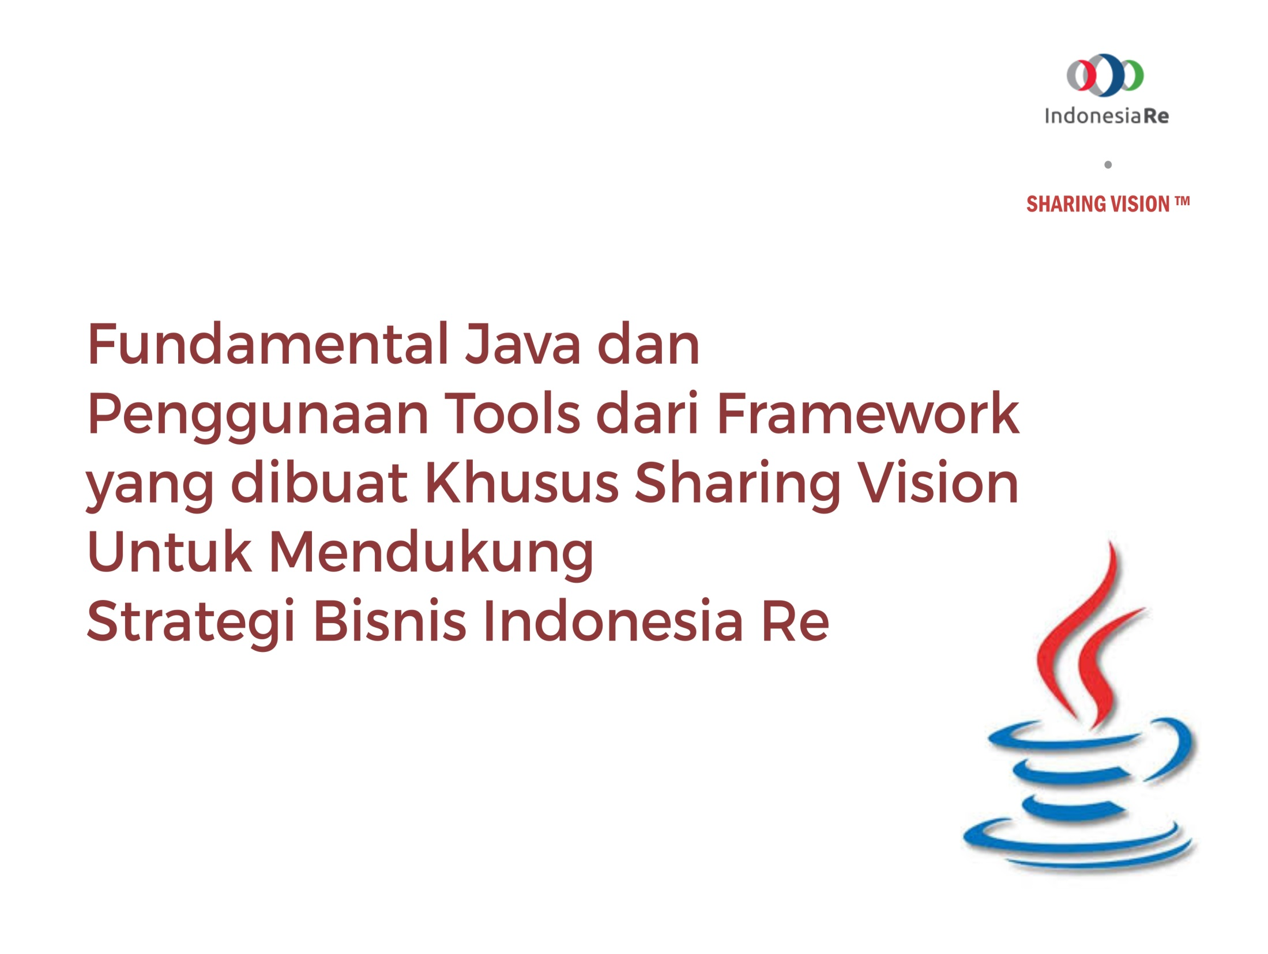

Slide 2
Dasar-Dasar Pemograman Java
@Indonesia Reinsurance

Slide 3
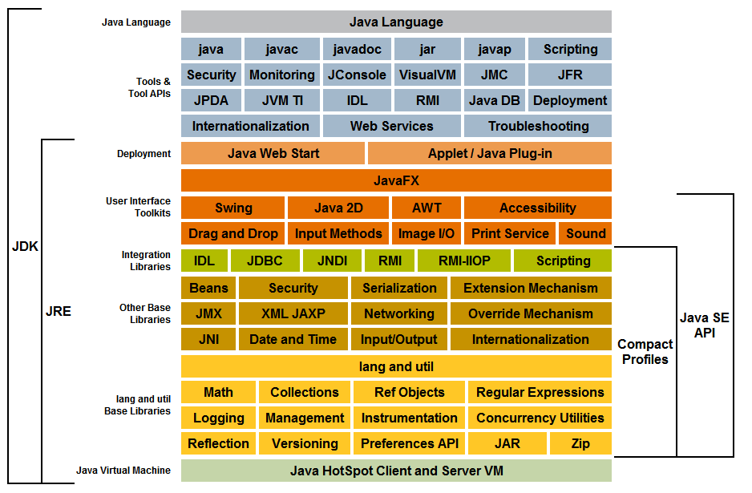
Java?

Slide 4
JVM
NAME
java − Java interpreter
SYNOPSIS
java [ options ] class [ argument ... ]
java [ options ] −jar file.jar [ argument ... ]
PARAMETERS
Options may be in any order. For a discussion of parameters which apply to a specific option, see OPTIONS below.
options
Command-line options. See OPTIONS below.
class
Name of the class to be invoked.
file.jar
Name of the jar file to be invoked. Used only with the −jar option.
DESCRIPTION
The java utility launches a Java application. It does this by starting a Java runtime environment, loading a specified class, and invoking that class’s main method. The method must have the following signature:
public static void main(String args[])
The method must be declared public and static, it must not return any value, and it must accept a String array as a parameter. By default, the first non-option argument is the name of the class to be invoked. A fully-qualified class name should be used. If the −jar option is specified, the first non-option argument is the name of a JAR archive containing class and resource files for the application, with the startup class indicated by the Main-Class manifest header.
The Java runtime searches for the startup class, and other classes used, in three sets of locations: the bootstrap class path, the installed extensions, and the user class path.
Non-option arguments after the class name or JAR file name are passed to the main function.

Slide 5
Java Compiler
NAME
javac − javac
SYNOPSIS
javac <options> <sourcefiles>...
DESCRIPTION
This is the jikes java compiler.
where options include:
−g
Generate all debugging info
−g:none
Generate no debugging info
−g:{lines,vars,source}
Generate only some debugging info
−nowarn
Generate no warnings
−verbose
Output messages about what the compiler is doing
−deprecation
Output source locations where deprecated APIs are used
−classpath <path>
Specify where to find user class files
−sourcepath <path>
Specify where to find input source files
−bootclasspath <path>
Override location of bootstrap class files
−extdirs <dirs>
Override location of installed extensions
−d <directory>
Specify where to place generated class files
−encoding <encoding>
Specify character encoding used by source files
−source <release>
Provide source compatibility with specified release
−target <release>
Generate class files for specific VM version
−help
Print a synopsis of standard options

Slide 6
Java Documentation
NAME
javadoc − javadoc
SYNOPSIS
javadoc <options> <packagenames> | <sourcefiles> | <classnames> | <@files>
DESCRIPTION
Tool to create documentation from Java source files.
where options include: −overview <file> Read overview documentation from HTML file −public Show only public classes and members −protected Show protected/public classes and members (default) −package Show package/protected/public classes and members −private Show all classes and members −help Display command line options and exit −doclet <class> Generate output via alternate doclet −docletpath <path> Specify where to find doclet class files −sourcepath <pathlist> Specify where to find source files −classpath <pathlist> Specify where to find user class files −exclude <pkglist> Specify a list of packages to exclude −subpackages <subpkglist> Specify subpackages to recursively load −breakiterator Compute 1st sentence with BreakIterator −bootclasspath <pathlist> Override location of class files loaded by the bootstrap class loader
−source <release> Provide source compatibility with specified release −extdirs <dirlist> Override location of installed extensions −verbose Output messages about what Javadoc is doing −locale <name> Locale to be used, e.g. en_US or en_US_WIN −encoding <name> Source file encoding name −J<flag> Pass <flag> directly to the runtime
System provided by Standard doclet: −d <directory> Destination directory for output files

Slide 7
Java Tools
IDE
Build Tools

Slide 8
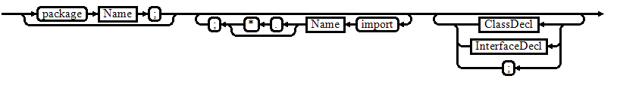

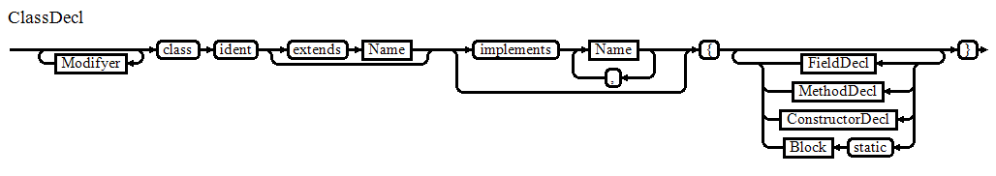
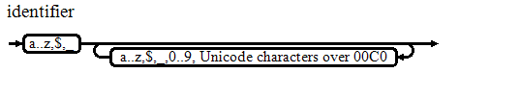
Java Compilation Unit

Slide 9
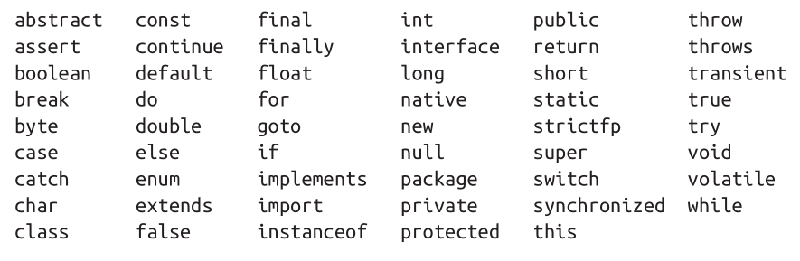
Java Keywords

Slide 10

Simple Java Program

Slide 11
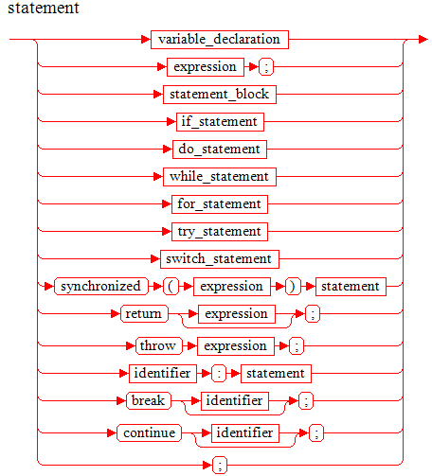
Statement

Slide 12

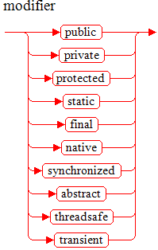

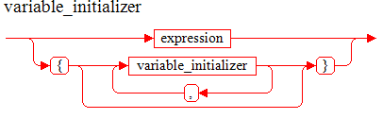
Deklarasi Variabel

Slide 13
Identifier
Identifier:
IdentifierChars but not a Keyword or BooleanLiteral or NullLiteral
IdentifierChars:
JavaLetter {JavaLetterOrDigit}
JavaLetter:
any Unicode character that is a "Java letter"
JavaLetterOrDigit:
any Unicode character that is a "Java letter-or-digit"
BooleanLiteral:
(one of) true false
NullLiteral:
null

Slide 14
Literal
IntegerLiteral
FloatingPointLiteral
BooleanLiteral
CharacterLiteral
StringLiteral
NullLiteral

Slide 15
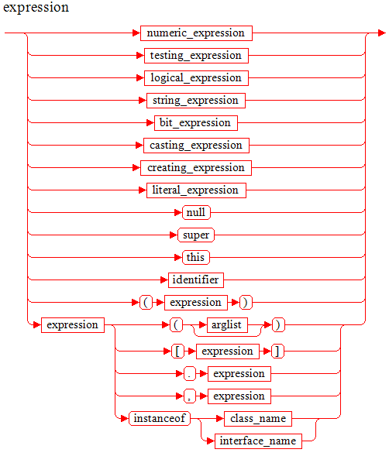
Ekpresi

Slide 16
Type?
Variable
Argument
Return Type
Operation

Slide 17
Primitive Type
Nama Type bagian dari keyword/reserved word
Pass by value
operasi terdefinisi di java dan final.

Slide 18
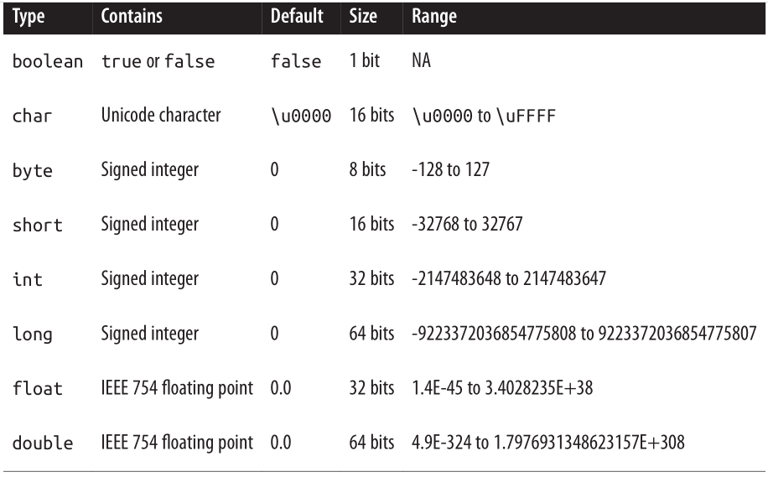
Primitive Type (kapasitas)

Slide 19
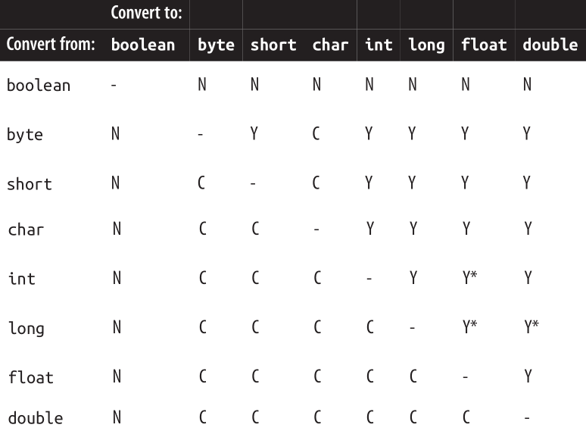
Primitive Type (konversi)
N = Tidak bisa di konversi, C = Bisa Dikonvesi Sempurna
Y = Bisa Dikonversi dgn Peluasan, * terjadi penyesuaian presisi nilai

Slide 20
Primitive Type (casting)
Down Casting
Up Casting
int i = 10;
byte b = (byte) i;
Java tidak melakukan down casting secara otomatis (implisit) karena ada kemungkinan terjadi kerusakan data/presisi.
byte b = 10;
int i = (byte) b;
Java bisa melakukan up casting secara otomatis (implisit).

Slide 21
Primitive Type (char)
karakter (char) pada java menggunakan standar UNICODE 16-bit.
Character (wapper dari char) memiliki beberapa fungsi khusus untuk UNICODE spt isLetter, isDigit, isWhitespace, isUpperCase, isLowerCase, toUpperCase, toLowerCase dkk.
char mendukung escape karakter seperti halnya C\C++.

Slide 22
Primitive Type (escape char)
Escape Sequence | Description
\t | Tab.
\b | Backspace.
\n | Newline.
\r | Carriage Return
\f | Formfeed
\' | Single quote/ petik satu
\" | Double quote/ petik ganda
\\ | Backslash
\xxx | Dimana xxx adalah index karakter dari UNICODE-16 dalam angka oktal.
\uxxxx | Dimana xxxx adalah index karakter dari UNICODE-16 dalam angka hexadesimal

Slide 23
Primitive Type (wrapper)
Setiap primitive type memiliki padanan Reference Type yg berperan memberikan fitur2 tambahan.
boolean ➔ Boolean
byte ➔ Byte
short ➔ Short
char ➔ Character
int ➔ Integer
long ➔ Long
float ➔ Float
double ➔ Double
Boxing = perubahan dari primitive ke reference type
Unboxing = perubahan dari reference type ke primitive

Slide 24
Reference Type
Nama Type sesuai aturan identifier java
Pass By Reference
Operasi di definisikan.

Slide 25
Operator
Category | Operator | Associativity
Postfix | () [] . (dot operator) | Kiri ke Kanan
Unary | ++ - - ! ~ | Kanan ke Kiri
Multiplicative | * / | Kiri ke Kanan
Additive | + - | Kiri ke Kanan
Shift | >> >>> << | Kiri ke Kanan
Relational | > >= < < = | Kiri ke Kanan
Equality | == != | Kiri ke Kanan
Bitwise AND | & | Kiri ke Kanan
Bitwise XOR | ^ | Kiri ke Kanan
Bitwise OR | | | Kiri ke Kanan
Logical AND | && | Kiri ke Kanan
Logical OR | || | Kiri ke Kanan
Conditional | ?: | Kanan ke Kiri
Assignment | = += -= *= /= %= >>= >>>= <<= &= ^= |= | Kanan ke Kiri

Slide 26
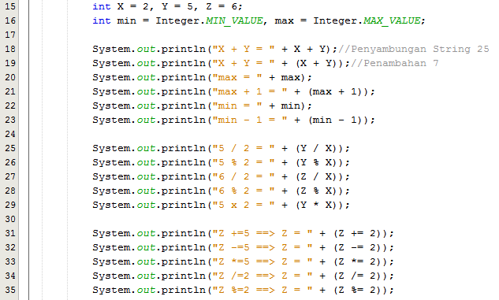
Operator (Arithmetic-Integer Operation)

Slide 27
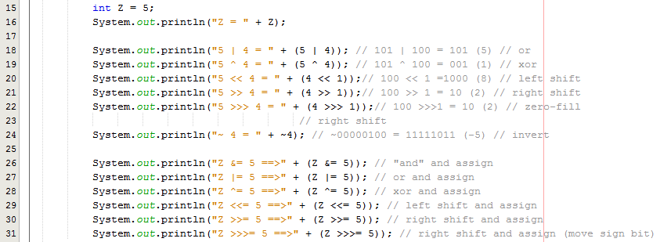
Operator (Bitwise)

Slide 28
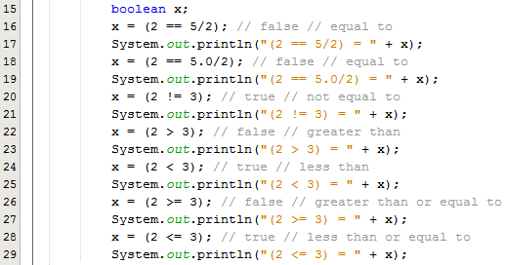
Operator (Perbandingan)

Slide 29

Operator (Logika)

Slide 30
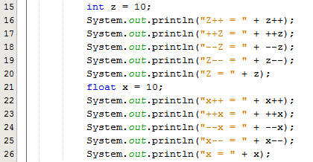
Operator (Inc/Dec)

Slide 31
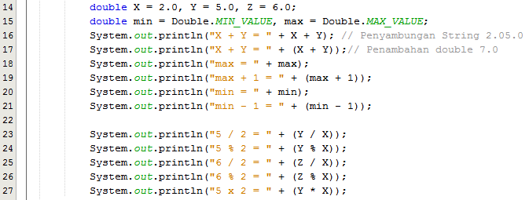
Operator (Floating Point)

Slide 32

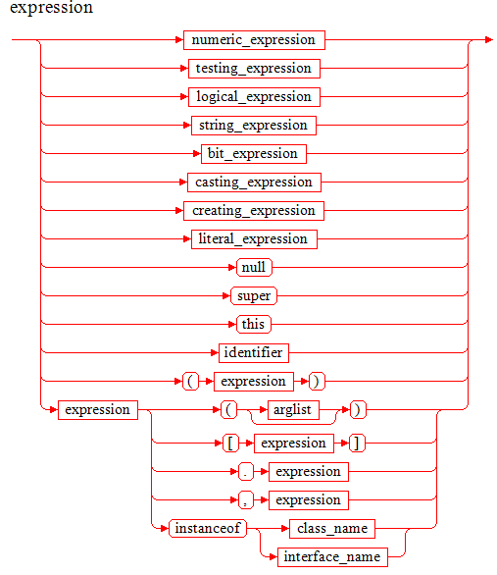
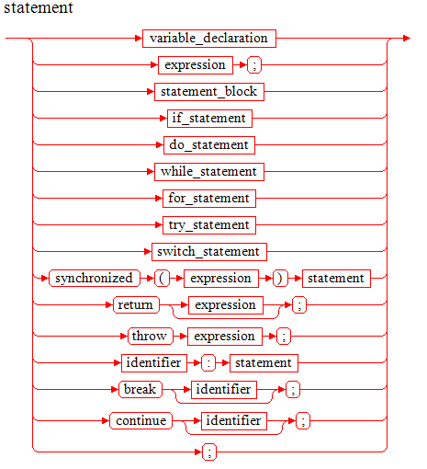
Control Flow (If-Else)
The Expression must have type boolean or Boolean, or a compile-time error occurs.

Slide 33
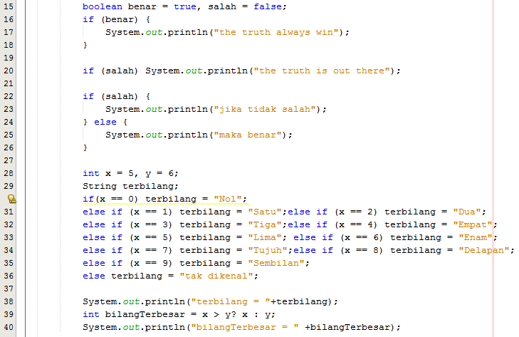
Control Flow (…If-Else)

Slide 34
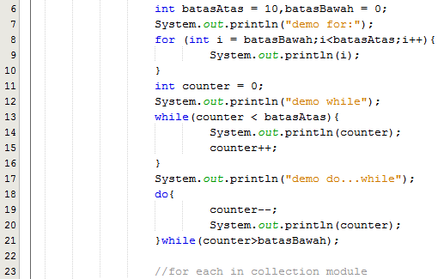
Control Flow (Perulangan)

Slide 35
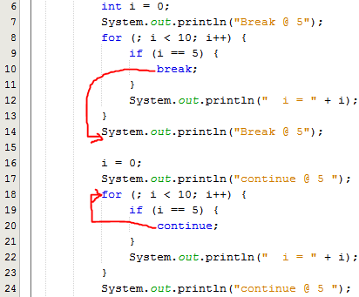
Control Flow (Label Block)

Slide 36
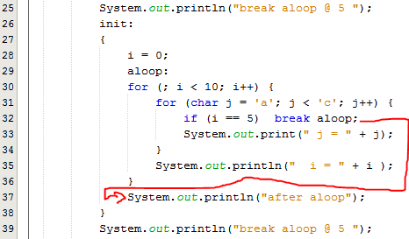
Control Flow (…Label Block)

Slide 37
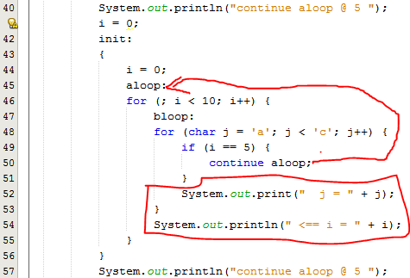
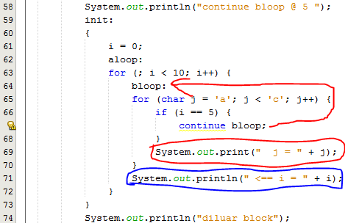
Control Flow (…Label Block)

Slide 38
Control Flow (Exception Handling)
Java punya 2 jenis kesalahan (Throwable )
Error, kesalahan fatal pada sistem, aplikasi tidak disarankan menanggulangi ini.
Exception, disarankan untuk ditanggulangi oleh aplikasi.
Java membagi 2 jenis Exception
Run Time Exception (java.lang.RuntimeException)
Compile Time/Checked Excepition( non - java.lang.RuntimeException)
Jangan gunakan exception untuk kesalahan logika bisnis/aplikasi.
Notes:
Unchecked exceptions: represent defects in the program (bugs) - often invalid arguments passed to a non-private method. To quote from The Java Programming Language, by Gosling, Arnold, and Holmes: "Unchecked runtime exceptions represent conditions that, generally speaking, reflect errors in your program's logic and cannot be reasonably recovered from at run time."
are subclasses of RuntimeException, and are usually implemented using IllegalArgumentException, NullPointerException, or IllegalStateException
a method is not obliged to establish a policy for the unchecked exceptions thrown by its implementation (and they almost always do not do so)
Checked exceptions: represent invalid conditions in areas outside the immediate control of the program (invalid user input, database problems, network outages, absent files)
are subclasses of Exception
a method is obliged to establish a policy for all checked exceptions thrown by its implementation (either pass the checked exception further up the stack, or handle it somehow)

Slide 39

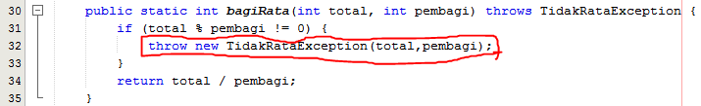
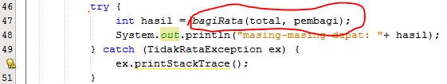
Control Flow (Checked Exception)

Slide 40
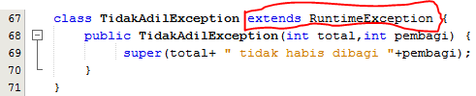
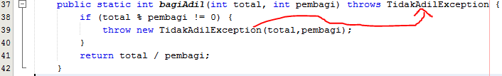

Control Flow (Runtime Exception)

Slide 41
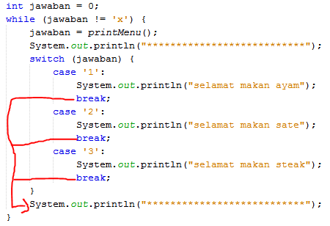
Control Flow (switch-case)

Slide 42
Reference Type
Java merupakan bahasa pemograman yang mendukung paradigma Object-Oriented Programming yang berbasis kelas.
Kelas (class) di java sering juga disebut reference type, atau singkatnya type.
Kelas merupakan “cetak-biru” untuk sebuah object.
Selain Kelas java juga mengenal interface, variable dan array.
Java memiliki beberapa Kelas yang istimewa seperti Object, Array, Enum dkk.

Slide 43

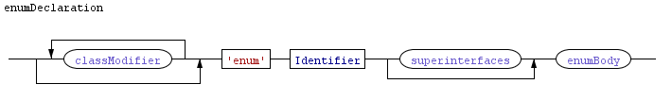
Deklarasi Kelas

Slide 44

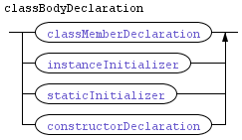
…Deklarasi Kelas

Slide 45


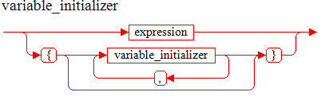
Deklarasi Variabel Kelas

Slide 46



Deklarasi Metode Kelas

Slide 47
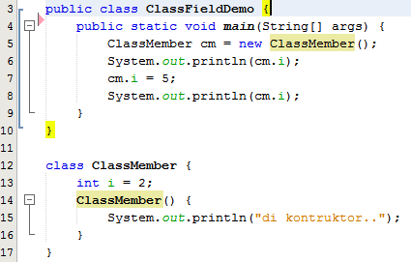
Sample Field Declaration

Slide 48
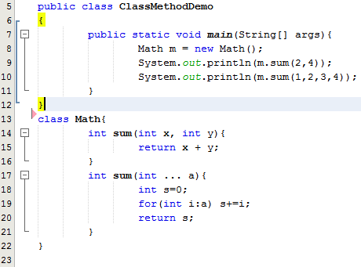
Sample Method Declaration

Slide 49
Method Overloading
Beberapa metode memiliki nama sama, dan bedakan berdasarkan parameternya.

Slide 50
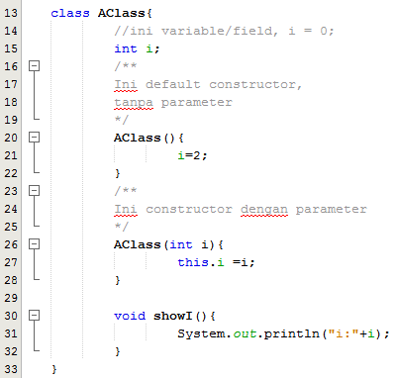
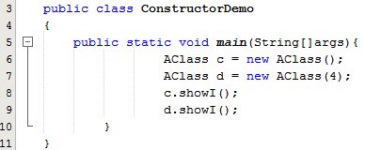
Kelas Konstruktor

Slide 51
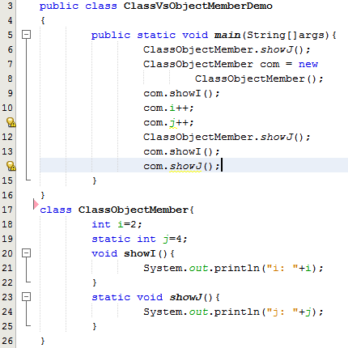
Static

Slide 52
java.lang.Object
Class Object is the root of the class hierarchy. Every class has Object as a superclass. All objects, including arrays, implement the methods of this class.
protected Object | clone() Creates and returns a copy of this object.
boolean | equals(Object obj) Indicates whether some other object is "equal to" this one.
protected void | finalize() Called by the garbage collector on an object when garbage collection determines that there are no more references to the object.
Class<?> | getClass() Returns the runtime class of this Object.
int | hashCode() Returns a hash code value for the object.
void | notify() Wakes up a single thread that is waiting on this object's monitor.
void | notifyAll() Wakes up all threads that are waiting on this object's monitor.
String | toString() Returns a string representation of the object.
void | wait() Causes the current thread to wait until another thread invokes the notify() method or the notifyAll() method for this object.
void | wait(long timeout) Causes the current thread to wait until either another thread invokes the notify() method or the notifyAll() method for this object, or a specified amount of time has elapsed.
void | wait(long timeout, int nanos) Causes the current thread to wait until another thread invokes the notify() method or the notifyAll() method for this object, or some other thread interrupts the current thread, or a certain amount of real time has elapsed.

Slide 53
javabeans
In order to function as a JavaBean class, an object class must obey certain conventions about method naming, construction, and behaviour. These conventions make it possible to have tools that can use, reuse, replace, and connect Java Beans.
The required conventions are as follows:
The class must have a public default constructor (with no arguments). This allows easy instantiation within editing and activation frameworks.
The class properties must be accessible using get, set, is (can be used for boolean properties instead of get), and other methods (so-called accessor methods and mutator methods) according to a standard naming convention. This allows easy automated inspection and updating of bean state within frameworks, many of which include custom editors for various types of properties. Setters can have one or more than one argument.
The class should be serializable. [This allows applications and frameworks to reliably save, store, and restore the bean's state in a manner independent of the VM and of the platform.]
source : https://en.wikipedia.org/wiki/JavaBeans#JavaBean_conventions

Slide 54
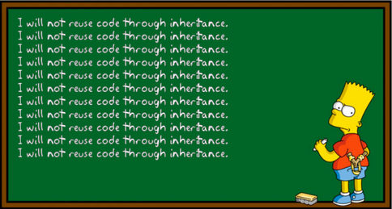
Hubungan antara kelas
Komposisi
Inheritance
Favor 'object composition' over 'class inheritance'.“

Slide 55
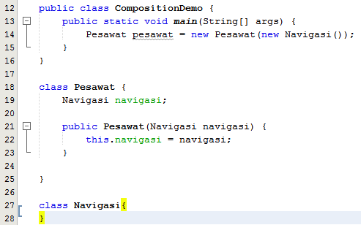
Komposisi Kelas

Slide 56


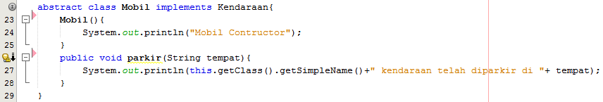
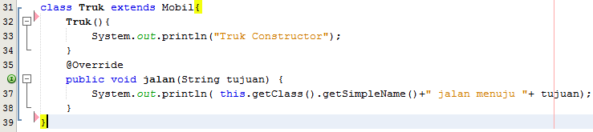
Inheritance

Slide 57
SOLID kode
Single responsibility principle, Sebuah object sebaiknya hanya memiliki satu tanggung jawab, membuat object tersebut mudah di kenali dengan kohesif.
Open/closed principle, mudah (terbuka) untuk dikembangkan, sulit untuk dimodifikasi.
Liskov substitution principle, obyek dalam sebuah program bisa di ganti instance sub-tipe nya tanpa mengubah kebenaran dari program tersebut.
Interface segregation principle, beberapa interface spesifik lebih baik dibanding, satu interface yang umum.
Dependency inversion principle, kode client/user harus tergantung pada interface/abstraksi bukan pada implementasi.

Slide 58
Generic
Generic adalah fitur baru mulai j2se 5 untuk memungkinkan meningkatkan “re-uses” tanpa kehilangan “type safety”.
“code re-use” meningkatkan penggunaan ulang kode, salah satunya dengan menggunakan inherintance.
“type safety”, bahasa pemograman seperti java (strong type language) menjamin semua storage (variable) hanya bisa berisi dengan nilai yang tipenya cocok.
Salah satu kelemahan dari penggunaan inheritance untuk meningkatkan “reuse” adalah berkurangnya type-safety karena type semakin general/umum.

Slide 59
Collections (Array)
Jumlah elemen fix diawal.
Hanya berisi elemen dengan tipe yang sama
Memiliki public final field length, yang berisi kapasitas array.
Clone di array di override untuk mengembalikan type T[].
Clone multi dimensi array shallow.
Implement Clonable dan java.io.Serializable
Java API menyediakan class Arrays untuk manipulasi array.
index dimulai dari 0.

Slide 60
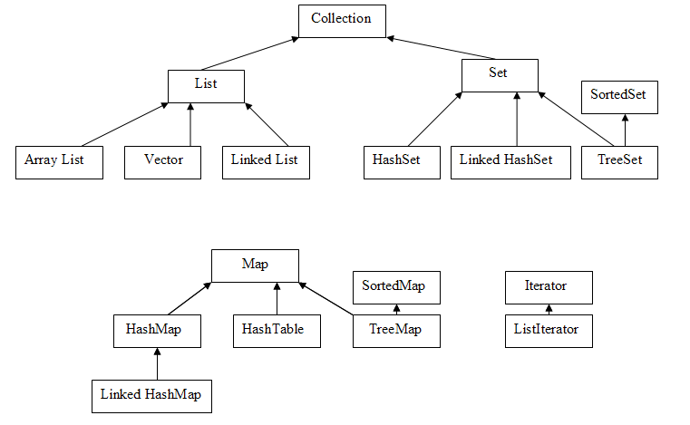
Collections

Slide 61
Collections (List)
Seperti array hanya bisa memiliki kapasitas secara dinamik.
Memiliki berbagai jenis implementasi dengan karakteristik yang lebih kaya.
Bisa memiliki duplikasi.
Ordered.

Slide 62
Collection (Set)
Seperti List tapi elementnya unique dengan perbandingan e1.equals(e2).
Hanya boleh memiliki satu null, jika null diperbolehkan.

Slide 63
Collection (Map)
Berbentuk dictionary/kamus, key => value
Pencarian menggunakan kunci dengan prinsip “kembalian true jika dan hanya jika map ini memiliki sebuah key k yang (key==null ? k==null : key.equals(k)).“

Slide 64
I/O (Stream)
di Java IO disebut dengan Stream. Streams adalah serangkaian data terurut yang memiliki sumber (input streams) atau tujuan (output streams).
Java API menyediakan dua jenis I/O, java.io, dan java.nio
java.nio package dan subpackages-nya mendifinisikan I/O dalam bentuk buffer and channel. Buffer adalah data yang disimpan (seperti array) yang bisa dibaca dan ditulis. Channel merepresentasika koneksi ke entity yang mampu melakukan operasi I/O termasuk buffer, file dan sockets.
Notes:
The "n" in nio is commonly understood as meaning "new" (the nio package predates the original stream-based io package), but it originally stood for "non-blocking" because one of the key differences between channel-based I/O and stream-based I/O is that channels allow for non-blocking I/O operations, as well as interruptible blocking operations.

Slide 65
Jenis-jenis Stream
Package java.io memiliki dua bagian utama: character streams dan byte streams.
Characters adalah16-bit UTF-16, sedangkan bytes are 8 bit integer.
I/O bisa berupa text-based atau data-based (binary).
Byte stream disebut input stream dan output stream, dan character stream disebut reader and writer.
Hampir semua stream
Notes:
The package java.io has two major parts: character streams and byte streams. Characters are 16-bit UTF-16 characters, whereas bytes are (as always) 8 bits. I/O is either text-based or data-based (binary). Text-based I/O works with streams of human-readable characters, such as the source code for a program. Data-based I/O works with streams of binary data, such as the bit pattern for an image. The character streams are used for text-based I/O, while byte streams are used for data-based I/O. Streams that work with bytes cannot properly carry characters, and some character-related issues are not meaningful with byte streams, though the byte streams can also be used for older text-based protocols that use 7- or 8-bit characters. The byte streams are called input streams and output streams, and the character streams are called readers and writers. For nearly every input stream there is a corresponding output stream, and for most input or output streams there is a corresponding reader or writer character stream of similar functionality, and vice versa.

Slide 66
Kelompok pada java.io classes and interfaces
Kelas untuk membuat berbagai tipe stream
Kelas Tipe-tipe Stream dan Filtered Stream
Buffer Stream
Pipe Stream dll.
Notes:
The classes and interfaces that form the object serialization mechanism, which transforms objects into byte streams and allows objects to be reconstituted from the data read from a byte stream.
Some of the output streams provide convenience methods for producing formatted output, using instances of the java.util.Formatter class. You get formatted input by binding an input stream to a java.util.Scanner object.
The IOException class is used by many methods in java.io to signal exceptional conditions. Some extended classes of IOException signal specific problems, but most problems are signaled by an IOException object with a descriptive string. Any method that throws an IOException will do so when an error occurs that is directly related to the stream. In particular, invoking a method on a closed stream may result in an IOException. Unless there are particular circumstances under which the IOException will be thrown, this exception is not documented for each individual method of each class.
Similarly, NullPointerException and IndexOutOfBoundsException can be expected to be thrown whenever a null reference is passed to a method, or a supplied index accesses outside of an array. Only those situations where this does not occur are explicitly documented.

Slide 67
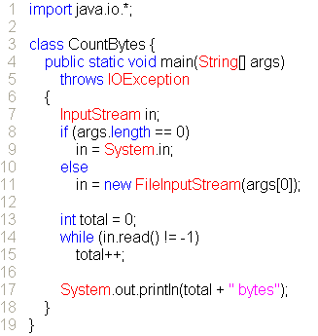
Byte Input Stream
Notes:
InputStream
The abstract class InputStream declares methods to read bytes from a particular source. InputStream is the superclass of most byte input streams in java.io, and has the following methods:
public abstract int read() throws IOException
Reads a single byte of data and returns the byte that was read, as an integer in the range 0 to 255, not 128 to 127; in other words, the byte value is treated as unsigned. If no byte is available because the end of the stream has been reached, the value 1 is returned. This method blocks until input is available, the end of stream is found, or an exception is thrown. The read method returns an int instead of an actual byte value because it needs to return all valid byte values plus a flag value to indicate the end of stream. This requires more values than can fit in a byte and so the larger int is used.
public int read(byte[] buf, int offset, int count) throws IOException
Reads into a part of a byte array. The maximum number of bytes read is count. The bytes are stored from buf[offset] up to a maximum of buf[offset+count-1]all other values in buf are left unchanged. The number of bytes actually read is returned. If no bytes are read because the end of the stream was found, the value 1 is returned. If count is zero then no bytes are read and zero is returned. This method blocks until input is available, the end of stream is found, or an exception is thrown. If the first byte cannot be read for any reason other than reaching the end of the streamin particular, if the stream has already been closed an IOException is thrown. Once a byte has been read, any failure that occurs while trying to read subsequent bytes is not reported with an exception but is treated as encountering the end of the stream the method completes normally and returns the number of bytes read before the failure occurred.
public int read(byte[] buf) throws IOException
Equivalent to read(buf,0, buf.length).
public long skip(long count) throws IOException
Skips as many as count bytes of input or until the end of the stream is found. Returns the actual number of bytes skipped. If count is negative, no bytes are skipped.
public int available() throws IOException
Returns the number of bytes that can be read (or skipped over) without blocking. The default implementation returns zero.
public void close() throws IOException
Closes the input stream. This method should be invoked to release any resources (such as file descriptors) associated with the stream. Once a stream has been closed, further operations on the stream will throw an IOException. Closing a previously closed stream has no effect. The default implementation of close does nothing.
The implementation of InputStream requires only that a subclass provide the single-byte variant of read because the other read methods are defined in terms of this one. Most streams, however, can improve performance by overriding other methods as well. The default implementations of available and close will usually need to be overridden as appropriate for a particular stream.
You might be tempted to set total using available, but it won't work on many kinds of streams. The available method returns the number of bytes that can be read without blocking. For a file, the number of bytes available is usually its entire contents. If System.in is a stream associated with a keyboard, the answer can be as low as zero; when there is no pending input, the next read will block.

Slide 68
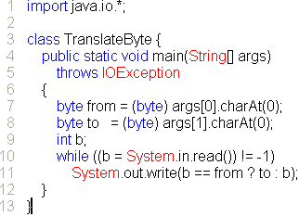
Byte Output Stream
Notes:
The abstract class OutputStream is analogous to InputStream; it provides an abstraction for writing bytes to a destination. Its methods are:
public abstract void write(int b) throws IOException
Writes b as a byte. The byte is passed as an int because it is often the result of an arithmetic operation on a byte. Expressions involving bytes are type int, so making the parameter an int means that the result can be passed without a cast to byte. Note, however, that only the lowest 8 bits of the integer are written. This method blocks until the byte is written.
public void write(byte[] buf, int offset, int count) tHRows IOException
Writes part of an array of bytes, starting at buf[offset] and writing count bytes. This method blocks until the bytes have been written.
public void write(byte[] buf) throws IOException
Equivalent to write(buf,0, buf.length).
public void flush() throws IOException
Flushes the stream. If the stream has buffered any bytes from the various write methods, flush writes them immediately to their destination. Then, if that destination is another stream, it is also flushed. One flush invocation will flush all the buffers in a chain of streams. If the stream is not buffered, flush may do nothing the default implementation. This method is defined in the Flushable interface.
public void close() throws IOException
Closes the output stream. This method should be invoked to release any resources (such as file descriptors) associated with the stream. Once a stream has been closed, further operations on the stream will throw an IOException. Closing a previously closed stream has no effect.The default implementation of close does nothing.
The implementation of OutputStream requires only that a subclass provide the single-byte variant of write because the other write methods are defined in terms of this one. Most streams, however, can improve performance by overriding other methods as well. The default implementations of flush and close will usually need to be overridden as appropriate for a particular streamin particular, buffered streams may need to flush when closed.

Slide 69
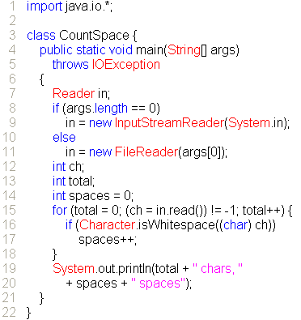
Character Streams – Reader
Notes:
The abstract class Reader provides a character stream analogous to the byte stream InputStream and the methods of Reader essentially mirror those of InputStream:
public int read() throws IOException
Reads a single character and returns it as an integer in the range 0 to 65535. If no character is available because the end of the stream has been reached, the value 1 is returned. This method blocks until input is available, the end of stream is found, or an exception is thrown.
public abstract int read(char[] buf, int offset, int count) throws IOException
Reads into a part of a char array. The maximum number of characters to read is count. The read characters are stored from buf[offset] up to a maximum of buf[offset+count-1]all other values in buf are left unchanged. The number of characters actually read is returned. If no characters are read because the end of the stream was found, 1 is returned. If count is zero then no characters are read and zero is returned. This method blocks until input is available, the end of stream is found, or an exception is thrown. If the first character cannot be read for any reason other than finding the end of the streamin particular, if the stream has already been closedan IOException is thrown. Once a character has been read, any failure that occurs while trying to read characters does not cause an exception, but is treated just like finding the end of the streamthe method completes normally and returns the number of characters read before the failure occurred.
public int read(char[] buf) throws IOException
Equivalent to read(buf,0, buf.length).
public int read(java.nio.CharBuffer buf) throws IOException
Attempts to read as many characters as possible into the specified character buffer, without overflowing it. The number of characters actually read is returned. If no characters are read because the end of the stream was found, 1 is returned. This is equivalent to reading into an array that has the same length as the buffer has available capacity, and then copying the array into the buffer. This method is defined in the java.lang.Readable interface, and has no counterpart in InputStream.
public long skip(long count) throws IOException
Skips as many as count characters of input or until the end of the stream is found. Returns the actual number of characters skipped. The value of count must not be negative.
public boolean ready() throws IOException
Returns true if the stream is ready to read; that is, there is at least one character available to be read. Note that a return value of false does not guarantee that the next invocation of read will block because data could have become available by the time the invocation occurs.
public abstract void close() throws IOException
Closes the stream. This method should be invoked to release any resources (such as file descriptors) associated with the stream. Once a stream has been closed, further operations on the stream will throw an IOException. Closing a previously closed stream has no effect.
The implementation of Reader requires that a subclass provide an implementation of both the read method that reads into a char array, and the close method. Many subclasses will be able to improve performance if they also override some of the other methods.

Slide 70
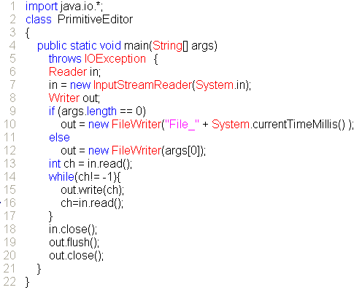
Character Streams – Writer
Notes:
There are a number of differences between Reader and InputStream. With Reader the fundamental reading method reads into a char array and the other read methods are defined in terms of this method. In contrast the InputStream class uses the single-byte read method as its fundamental reading method. In the Reader class subclasses must implement the abstract close method in contrast to inheriting an empty implementationmany stream classes will at least need to track whether or not they have been closed and so close will usually need to be overridden. Finally, where InputStream had an available method to tell you how much data was available to read, Reader simply has a ready method that tells you if there is any data.
The abstract class Writer provides a stream analogous to OutputStream but designed for use with characters instead of bytes. The methods of Writer essentially mirror those of OutputStream, but add some other useful forms of write:
public void write(int ch) throws IOException
Writes ch as a character. The character is passed as an int but only the lowest 16 bits of the integer are written. This method blocks until the character is written.
public abstract void write(char[] buf, int offset, int count) throws IOException
Writes part of an array of characters, starting at buf[offset] and writing count characters. This method blocks until the characters have been written.
public void write(char[] buf) throws IOException
Equivalent to write(buf,0, buf.length).
public void write(String str, int offset, int count) throws IOException
Writes count characters from the string str onto the stream, starting with str.charAt(offset).
public void write(String str) throws IOException
Equivalent to write(str,0, str.length()).
public abstract void flush() throws IOException
Flushes the stream. If the stream has buffered any characters from the various write methods, flush immediately writes them to their destination. Then, if that destination is another stream, it is also flushed. One flush invocation will flush all the buffers in a chain of streams. If a stream is not buffered flush will do nothing.
public abstract void close() throws IOException
Closes the stream, flushing if necessary. This method should be invoked to release any resources (such as file descriptors) associated with the stream. Once a stream has been closed, further operations on the stream will throw an IOException. Closing a previously closed stream has no effect.
Subclasses of Writer must implement the array writing variant of write, the close method, and the flush method. All other Writer methods are implemented in terms of these three. This contrasts with OutputStream which uses the single-byte variant of write method as the fundamental writing method, and which provides default implementations of flush and close. As with Reader, many subclasses can improve performance if they also override other methods.
Writer also implements the java.lang.Appendable interface. The append(char c) method is equivalent to write(c); the append methods that take a CharSequence are equivalent to passing the String representations of the CharSequence objects to the write(String str) method.

Slide 71
Data Byte Stream
Interface DataInput dan DataOuput memiliki method yang mentransmisikan primitive type melewati stream. DataInputStream dan DataOutputStream merupakan implementasi bawaanya.
Untuk setiap Interface data ada pasangan data streamnya, sebagai tambahan kelas RandomAccessFile mengimplementasikan Interface Input dan output.
Setiap kelas memiliki kelas pembantu untuk memfilter stream, dan kostruktor yang meminta input/output interface sebagai masukan.
Notes:
Read Write Type
readBoolean writeBoolean boolean
readChar writeChar char
readByte writeByte byte
readShort writeShort short
readInt writeInt int
readLong writeLong long
readFloat writeFloat float
readDouble writeDouble double
readUTF writeUTF String (in UTF format)
String values are read and written using a modified form of the UTF-8 character encoding. This differs from standard UTF-8 in three ways: the null byte (\u0000) is encoded in a 2-byte format so that the encoded string does not have embedded null bytes; only 1-byte, 2-byte, or 3-byte formats are used; and supplementary characters are encoded using surrogate pairs. Encoding Unicode characters into bytes is necessary in many situations because of the continuing transition from 8-bit to 16-bit character sets.
In addition to these paired methods, DataInput has several methods of its own, some of which are similar to those of InputStream:
public abstract void readFully(byte[] buf, int offset, int count) throws IOException
Reads into part of a byte array. The maximum number of bytes read is count. The bytes are stored from buf[offset] up to a maximum of buf[offset+count-1]. If count is zero then no bytes are read. This method blocks until input is available, the end of the file (that is, stream) is foundin which case an EOFException is thrownor an exception is thrown because of an I/O error.
public abstract void readFully(byte[] buf) tHRows IOException
Equivalent to readFully(buf,0, buf.length).
public abstract int skipBytes(int count) throws IOException
Attempts to skip over count bytes, discarding any bytes skipped over. Returns the actual number of bytes skipped. This method never throws an EOFException.
public abstract int readUnsignedByte() throws IOException
Reads one input byte, zero-extends it to type int, and returns the result, which is therefore in the range 0 through 255. This method is suitable for reading a byte written by the writeByte method of DataOutput if the argument to writeByte was a value in the range 0 through 255.
public abstract int readUnsignedShort() throws IOException
Reads two input bytes and returns an int value in the range 0 through 65535. The first byte read is made the high byte. This method is suitable for reading bytes written by the writeShort method of DataOutput if the argument to writeShort was a value in the range 0 through 65535.
The DataInput interface methods usually handle end-of-file (stream) by throwing EOFException when it occurs. EOFException extends IOException.

Slide 72
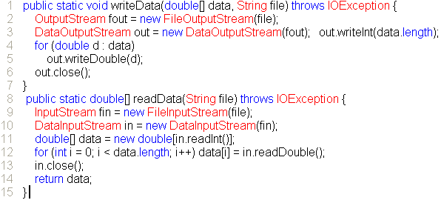
Notes:
The DataOutput interface supports signatures equivalent to the three forms of write in OutputStream and with the same specified behavior. Additionally, it provides the following unmirrored methods:
public abstract void writeBytes(String s) throws IOException
Writes a String as a sequence of bytes. The upper byte in each character is lost, so unless you are willing to lose data, use this method only for strings that contain characters between \u0000 and \u00ff.
public abstract void writeChars(String s) throws IOException
Writes a String as a sequence of char. Each character is written as two bytes with the high byte written first.
There are no readBytes or readChars methods to read the same number of characters written by a writeBytes or writeChars invocation, therefore you must use a loop on readByte or readChar to read strings written with these methods. To do that you need a way to determine the length of the string, perhaps by writing the length of the string first, or by using an end-of-sequence character to mark its end. You could use readFully to read a full array of bytes if you wrote the length first, but that won't work for writeChars because you want char values, not byte values.

Slide 73
Object Serialization
Proses mengubah objek menjadi byte stream yang siap ditransmisikan disebut serialization, mengembalikan byte stream menjadi object asal disebut de-serialization. di java semua object yang bisa di-serialization otomatis bisa di- deserialization.
Ketika sebuah ObjectOutputStream menulis obyek, obyeknya harus merupakan objek yang kelasnya mengimplementasikan interface Serialiable.
Notes:
The Object streamsObjectInputStream and ObjectOutputStreamallow you to read and write object graphs in addition to the well-known types (primitives, strings, and arrays). By "object graph" we mean that when you use writeObject to write an object to an ObjectOutputStream, bytes representing the objectincluding all other objects that it referencesare written to the stream. This process of transforming an object into a stream of bytes is called serialization. Because the serialized form is expressed in bytes, not characters, the Object streams have no Reader or Writer forms.
When bytes encoding a serialized graph of objects are read by the method readObject of ObjectInputStreamthat is, deserializedthe result is a graph of objects equivalent to the input graph.
Serialization preserves the integrity of the graph itself.

Slide 74
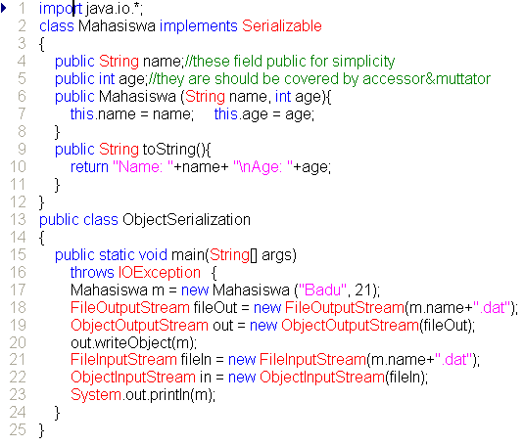
Notes:
Being serializable can be quite simple. The default serialization process is to serialize each field of the object that is neither TRansient nor static. Primitive types and strings are written in the same encoding used by DataOutputStream; objects are serialized by calling writeObject. With default serialization, all serialized fields that are object references must refer to serializable object types. Default serialization also requires either that your superclass have a no-arg constructor (so that deserialization can invoke it) or that it also be Serializable (in which case declaring your class to implement Serializable is redundant but harmless). For most classes this default serialization is sufficient, and the entire work necessary to make a class serializable is to mark it as such by declaring that it implements the Serializable interface
You will occasionally have a class that is generally serializable but has specific instances that are not serializable. For example, a container might itself be serializable but contain references to objects that are not serializable. Any attempt to serialize a non-serializable object will throw a NotSerializableException.

Slide 75
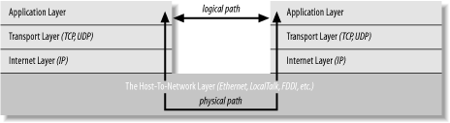
TCP/IP Networks Layer
Kelas-kelas pada java API hanya bekerja diatas jaringan TCP/IP dan selalu di layer transport atau application.
Protocol yang disupport java API hanya TCP dan UDP
Gunakan TCP untuk interaksi Connection-Oriented.
Gunakan UDP untuk interaksi Connectionless.
Notes:
If you read the network literature, you're likely to encounter an alternative seven-layer model called the Open Systems Interconnection Reference Model (OSI). For network programs in Java, the OSI model is overkill. The biggest difference between the OSI model and the TCP/IP model used in this book is that the OSI model splits the host-to-network layer into data link and physical layers and inserts presentation and session layers in between the application and transport layers. The OSI model is more general and better suited for non-TCP/IP networks, although most of the time it's still overly complex. In any case, Java's network classes only work on TCP/IP networks and always in the application or transport layers.
A number of other protocols can run on top of IP. The most commonly requested is ICMP, the Internet Control Message Protocol, which uses raw IP datagrams to relay error messages between hosts. The best-known use of this protocol is in the ping program. Java does not support ICMP nor does it allow the sending of raw IP datagrams (as opposed to TCP segments or UDP datagrams). The only protocols Java supports are TCP and UDP, and application layer protocols built on top of these. All other transport layer, internet layer, and lower layer protocols such as ICMP, IGMP, ARP, RARP, RSVP, and others can only be implemented in Java programs by using native code.
TCP (Connection-Oriented) was layered on top of IP to give each end of a connection the ability to acknowledge receipt of IP packets and request retransmission of lost or corrupted packets. Furthermore, TCP allows the packets to be put back together on the receiving end in the same order they were sent.
UDP (Connectionless Style) is an unreliable protocol that does not guarantee that packets will arrive at their destination or that they will arrive in the same order they were sent.

Slide 76

Socket – Client
Notes:
A socket is a connection between two hosts. It can perform seven basic operations:
Connect to a remote machine
Send data
Receive data
Close a connection
Bind to a port
Listen for incoming data
Accept connections from remote machines on the bound port
Java's Socket class, which is used by both clients and servers, has methods that correspond to the first four of these operations. The last three operations are needed only by servers, which wait for clients to connect to them. They are implemented by the ServerSocket class, which is discussed in the next chapter. Java programs normally use client sockets in the following fashion:
The program creates a new socket with a constructor.
The socket attempts to connect to the remote host.
Once the connection is established, the local and remote hosts get input and output streams from the socket and use those streams to send data to each other. This connection is full-duplex; both hosts can send and receive data simultaneously. What the data means depends on the protocol; different commands are sent to an FTP server than to an HTTP server. There will normally be some agreed-upon hand-shaking followed by the transmission of data from one to the other.
When the transmission of data is complete, one or both sides close the connection. Some protocols, such as HTTP 1.0, require the connection to be closed after each request is serviced. Others, such as FTP, allow multiple requests to be processed in a single connection.

Slide 77

Server Socket
Notes:
The ServerSocket class contains everything needed to write servers in Java. It has constructors that create new ServerSocket objects, methods that listen for connections on a specified port, methods that configure the various server socket options, and the usual miscellaneous methods such as toString( ).
In Java, the basic life cycle of a server program is:
A new ServerSocket is created on a particular port using a ServerSocket( ) constructor.
The ServerSocket listens for incoming connection attempts on that port using its accept( ) method. accept( ) blocks until a client attempts to make a connection, at which point accept( ) returns a Socket object connecting the client and the server.
Depending on the type of server, either the Socket's getInputStream() method, getOutputStream( ) method, or both are called to get input and output streams that communicate with the client.
The server and the client interact according to an agreed-upon protocol until it is time to close the connection.
The server, the client, or both close the connection.
The server returns to step 2 and waits for the next connection.

Slide 78
String (Basic Operation)
java.lang.String merupakan kelas khusus di java yang diperuntukan untuk menampung teks.
String bersifat shared dan immutable, artinya sekali dibuat dia tidak bisa diubah, dan kita tidak bisa membuat lebih dari satu String yang sama.
String mendukung operator “+” untuk menyambung. jika operator ini digabung dengan object non String, maka akan otomatis memanggil method “toString”.
String memiliki tingkah laku seperti halnya primitive tipe, contoh dia pass by value bukan by reference.
String memiliki method yang khusus untuk perbandingan, baik perbandingan yang peka terhadap “case” atau yang tidak peka terhadap “case”.

Slide 79
String (Formatting)
String merupakan array dari char di java, mendukung Escape Karakter seperti halnya C/C++.
Mulai versi 1.5 java mendukung pemormatan teks/string seperti halnya C/C++, dukungan bisa dilihat di kelas java.util.Formatter

Slide 80
String (Builder)
Karena String bersifat immutable maka java API menyediakan kelas khusus untuk String yang bisa dimanipulasi/diubah (muttable), StringBuffer dan StringBuilder.
StringBuilder mulai disediakan di java 1.5 dengan menghilangkan dukungan syncronisasi untuk meningkatkan performansi.

Slide 81

String (Regular Expression)

Slide 82
TTYL

Slide 83

Merci bien Arigatoo Matur Nuwun Hatur Nuhun
Matur se Kelangkong Syukron Kheili Mamnun Danke Terima Kasih

